Slide 1

Telco Customer Churn Analysis
Analyzing telecommunications data to identify patterns and drivers of customer attrition.

Slide 2

Project Overview
Identify Patterns
Key Drivers
Uncover churn behaviors and high-risk segments.
Pinpoint factors causing customers to leave.
Retention Strategy
Support data-driven approaches to keep customers.

Slide 3

Dataset Snapshot
Rows: 7,043
Columns: 33
Key Features:
Customer Profile (gender, senior, partner)
Account Info (contract, payment, tenure)
Service Usage (internet, phone, streaming)
Financials (charges, CLTV)
Churn Indicators (value, reason, score)

Slide 4
Data Preparation in Python
01
02
03
Data Loading & Exploration
Missing Data Handling
Column Standardization
Imported dataset, inspected structure and summary statistics.
Filled missing 'total_charges' with median, 'churn_reason' with "Not Churned".
Renamed columns to snake_case for consistency.
04
05
Feature Engineering
Database Integration
Created 'tenure_group' for churn analysis.
Loaded cleaned data into PostgreSQL for further analysis.

Slide 5

SQL Analysis: Key Metrics
7,043
1,869
Total Customers
Churned Customers
Active customers in the dataset.
Customers who have left the service.
26.5%
$64.76
Churn Rate
Avg. Monthly Charge
Percentage of customers who churned.
Average customer payment per month.

Slide 6

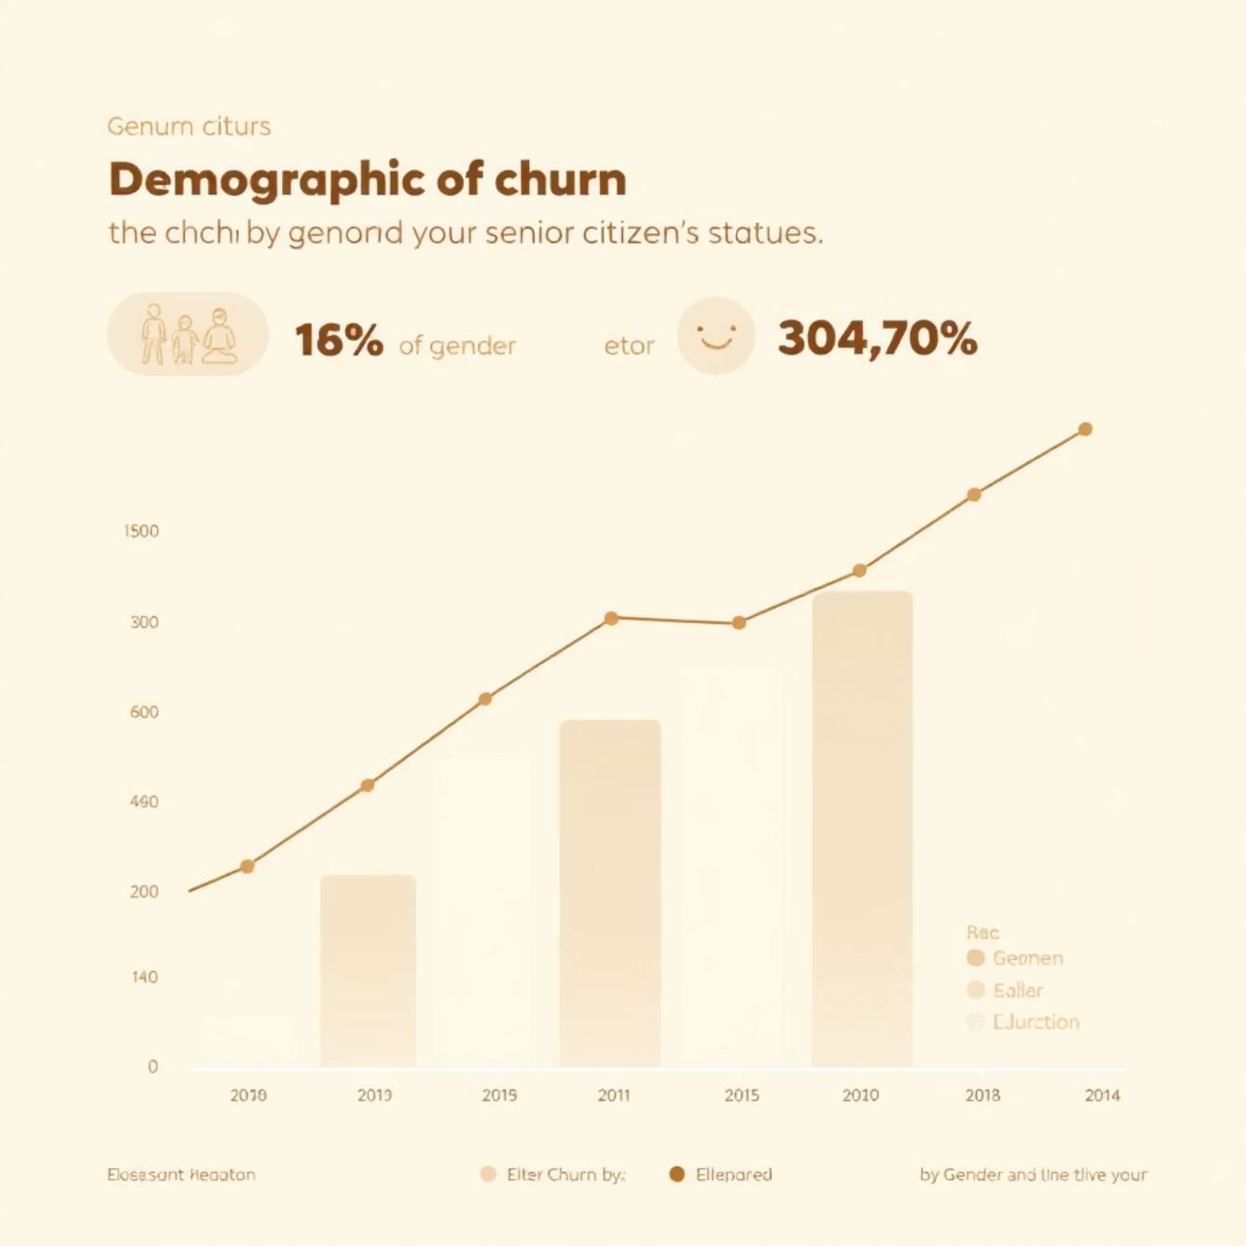
Churn Demographics
Gender & Seniority
Top 5 Churn Cities
Churn rates are similar across genders. Senior citizens show higher churn.
Los Angeles and San Diego have the highest churn numbers.

Slide 7


Service & Payment Impact on Churn
Internet Service
Payment Method
Fiber optic users contribute most to churn.
Electronic check users have the highest churn risk.
Contract Type
Month-to-month contracts show highest churn risk.

Slide 8
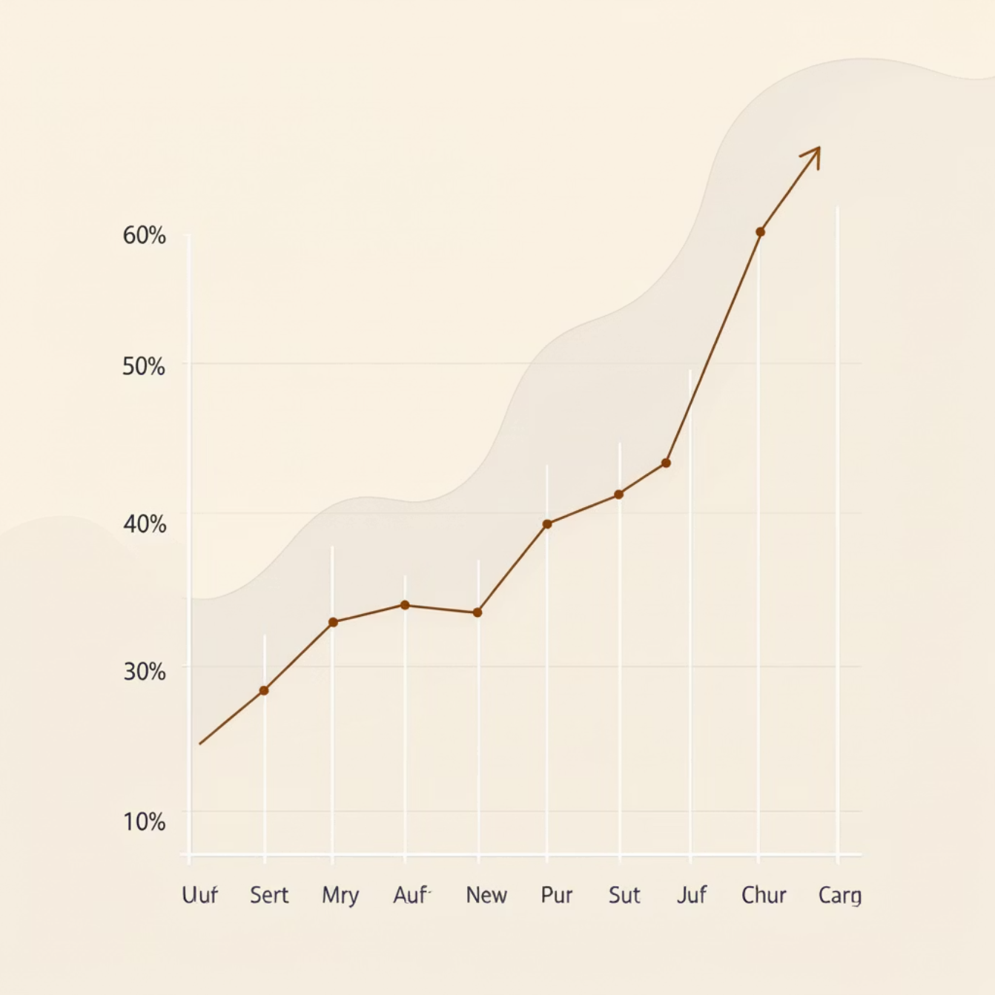
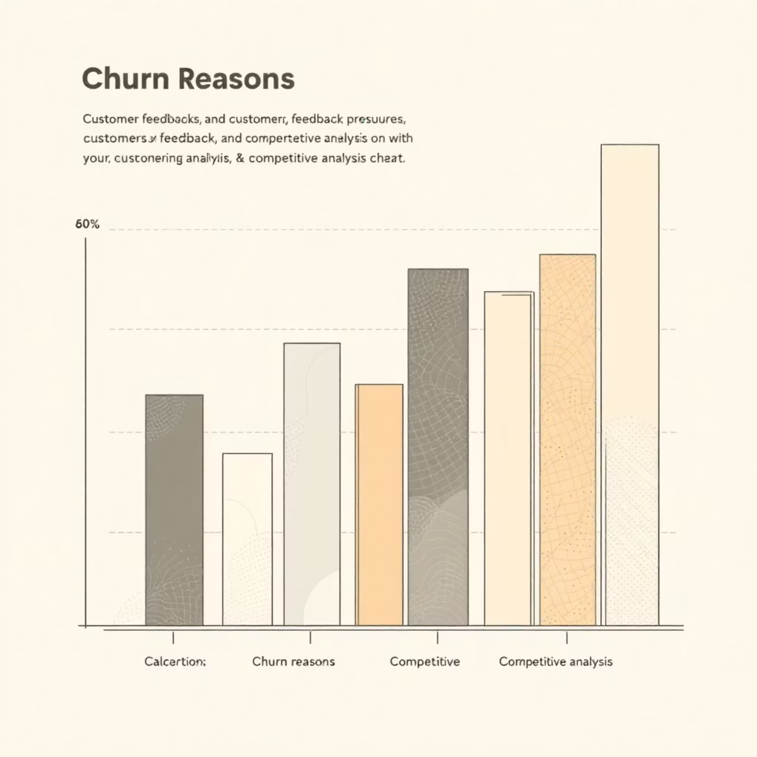
Churn by Tenure & Reason
Tenure Group
Top Churn Reasons
New customers (0-1 year) have the highest churn rate, decreasing with tenure.
Competitor offers, slow speeds, and poor service attitude are key drivers.

Slide 9
Business Recommendations
1
Convert Month-to-Month
Promote long-term contracts with incentives.
2
Reduce E-Check Churn
Encourage automatic payments with incentives.
3
Prioritize Fiber Optic
Improve service reliability and support for premium users.
4
Focus on New Customers
Strengthen onboarding and early-stage promotions.
5
Target High-Churn Cities
Implement localized retention campaigns.
6
Improve Service & Pricing
Review plans, upgrade network, enhance customer support.

